Slide 1
Advancing Biodiversity Research: The Evolution of Collaborative OPen Omics (COPO) Project
AALIYAH PROVIDENCE, PAPATHEODOROU GROUP
Junior Software Developer (COPO)
Notes:
Abstract: This seminar explores the evolution of the Collaborative OPen Omics (COPO) project as an open-source metadata broker in biodiversity research. With its capability to broker different data seamlessly, COPO has revolutionised the way by which researchers collaborate and share information. An integral part of COPO's development involves standardising as well as enriching metadata and enabling the integration of diverse datasets for publication to the European Nucleotide Archive (ENA) which facilitates public dissemination. Additionally, COPO's user-friendly API empowers users to query sample data efficiently, further enhancing accessibility and interoperability in biodiversity studies. Through its continuous evolution, COPO continues to drive innovation and collaboration in the field of bioscience research.

Slide 2
Overview
Evolution of COPO
Brokering different types of data
Data deposition to ENA
Future tasks
2

Slide 3






Evolution of COPO
COPO project was launched
Launched on September, 2014
Aim to improve open access to and management of data within plant research
Web based data brokering system
Built using Django and Python
Open-source tool based on data submissions via wizards
Data submitted is shared to repositories
Tree of Life (ToL) project partnership
DToL project was first brokered in June, 2020
ASG project was first brokered in July, 2020
Scientists describe research using sanctioned metadata
Subproject brokered
BGE subproject was first brokered
2018
2021
2023 - PRESENT
2014
2020
2022
Partnership with CGIAR
Provided a unified manner of capturing metadata
Incorporated CG Core metadata schema to capture agricultural resources across 15 CGIAR centres
Increased discoverability and interoperability of data
Third project brokered
ERGA project was brokered in September, 2021
COPO project was revamped
COPO was refactored
New logo design
Manifest version upgrade to 2.5
POP_GENOMICS subproject was first brokered
3
Notes:
2014 - COPO was launched in September, 2024 under the abbreviation - Collaborative Open Plant Omics. It was launched in Genome Analysis Centre (TGAC) which is what EI was known as at that time.
It’s open source which allows third parties to initiate their own versions of COPO.
_______________
2018 - CGIAR - was formerly the Consultative Group for International Agricultural Research.
COPO provided data annotation for the 15 Consultative Group on International Agricultural Research (CGIAR)
agricultural research for development centres.
____________________
Front page was revamped

Slide 4
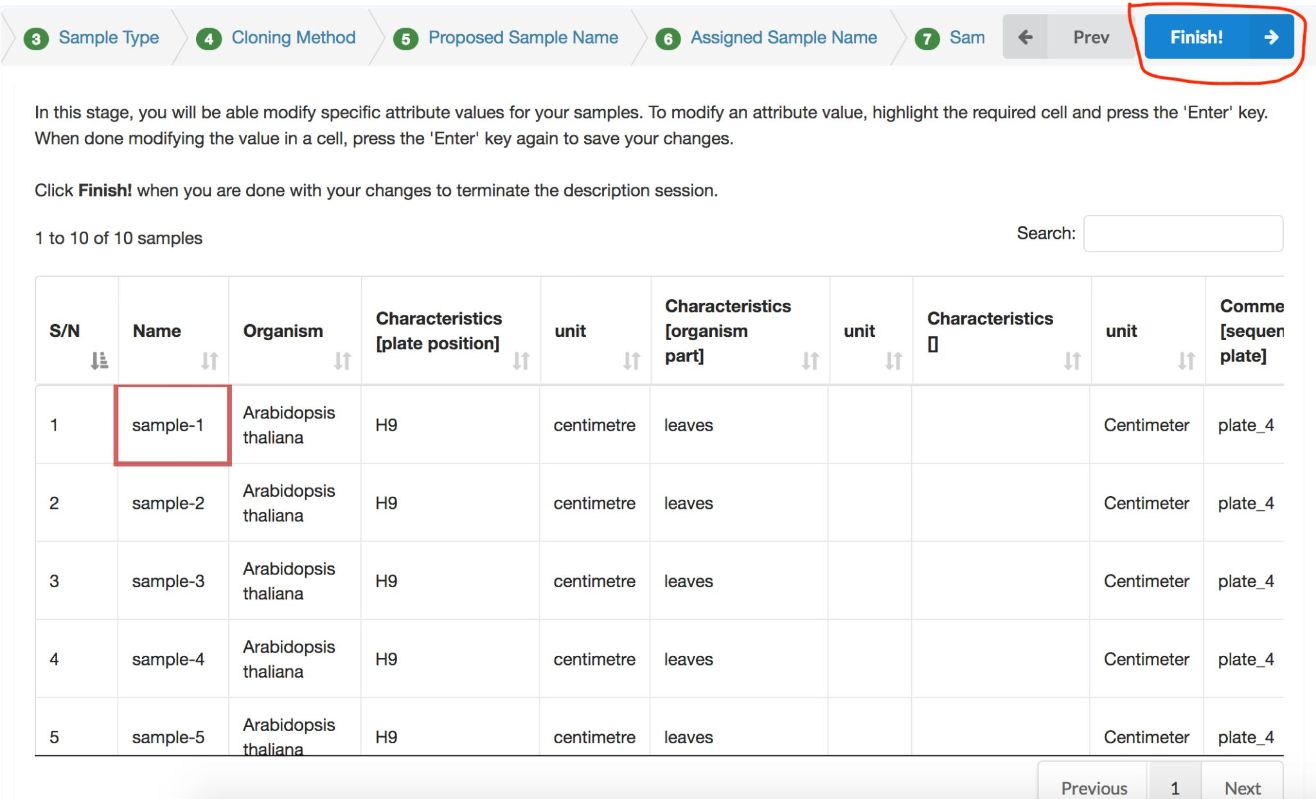
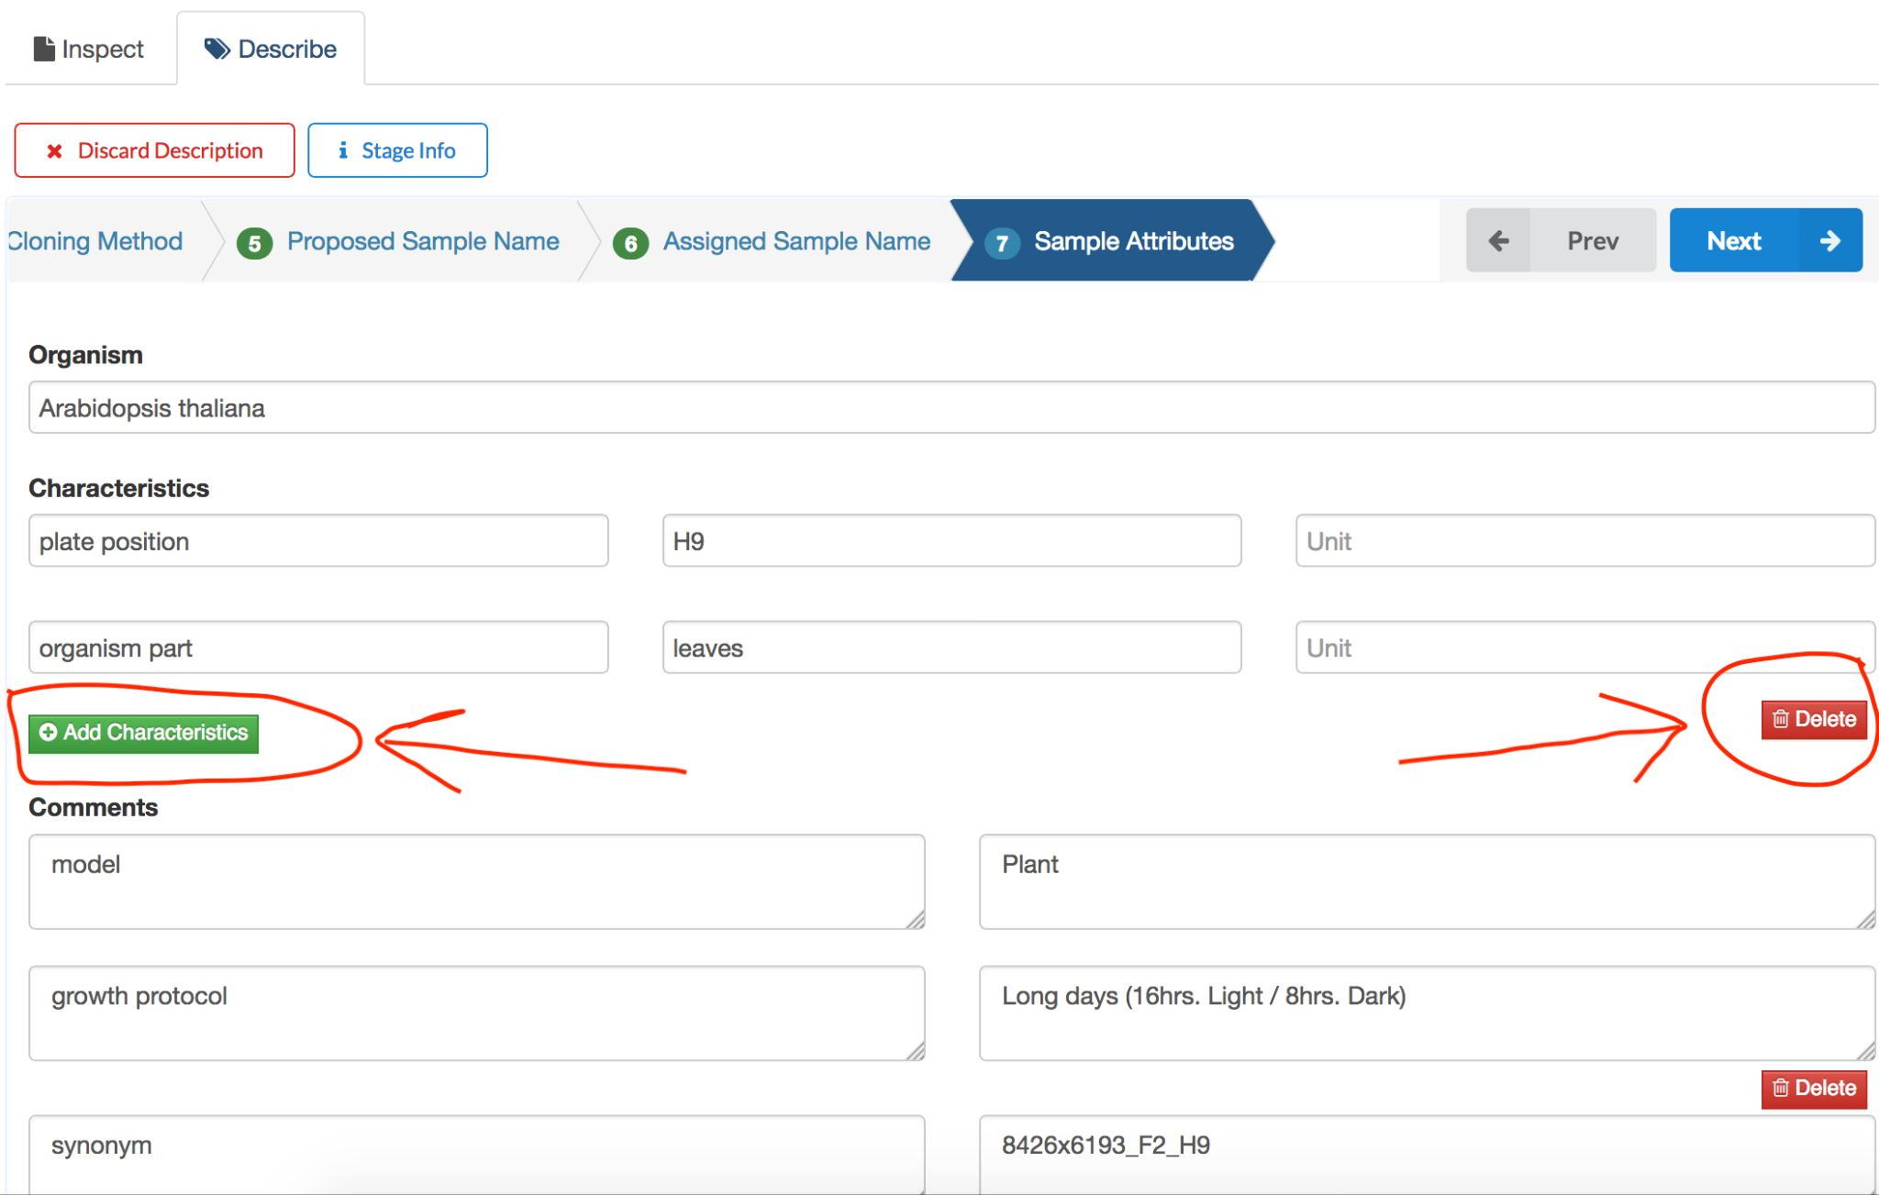
Evolution of COPO
For 6 years i.e. 2014 - 2020
Benefits
Involved in plant research only
Wizards were used to describe characteristics of data
Suitable for data submission comprising 15-20 samples
Drawbacks
Metadata had to be recorded online via wizards on COPO
Data submission failed or were tedious for more than 20 samples as JavaScript and other technologies fail to cope with the large number of data
4

Slide 5
Brokering different types of data
Samples
Reads
Sequence Annotations
Assemblies
Barcodes
5

Slide 6

Brokering different types of data
Samples
Aquatic Symbiosis Genomics (ASG) samples
Darwin Tree of Life (DToL) samples
European Reference Genome Atlas (ERGA) samples
Biodiversity Genomics Europe (BGE)
ERGA-Pilot
ERGA-Satellites
ERGA-Associated
Population Genomics (POP_GENOMICS)
Sample co-ordinators record the metadata collected in a spreadsheet, referred to as a manifest.
6
Notes:
Pros of using Excel spreadsheet for sample submission instead of a online wizard
Sample metadata can be recorded without online presence (unless one is using Google Spreadsheet)
Numerous metadata can be recorded
Number of columns/fields:
ASG: 68; DTOL: 68; ERGA: 91
Pandas is a Python library that COPO uses to analyse metadata submitted in spreadsheets. It manipulates and automates analysis quickly

Slide 7
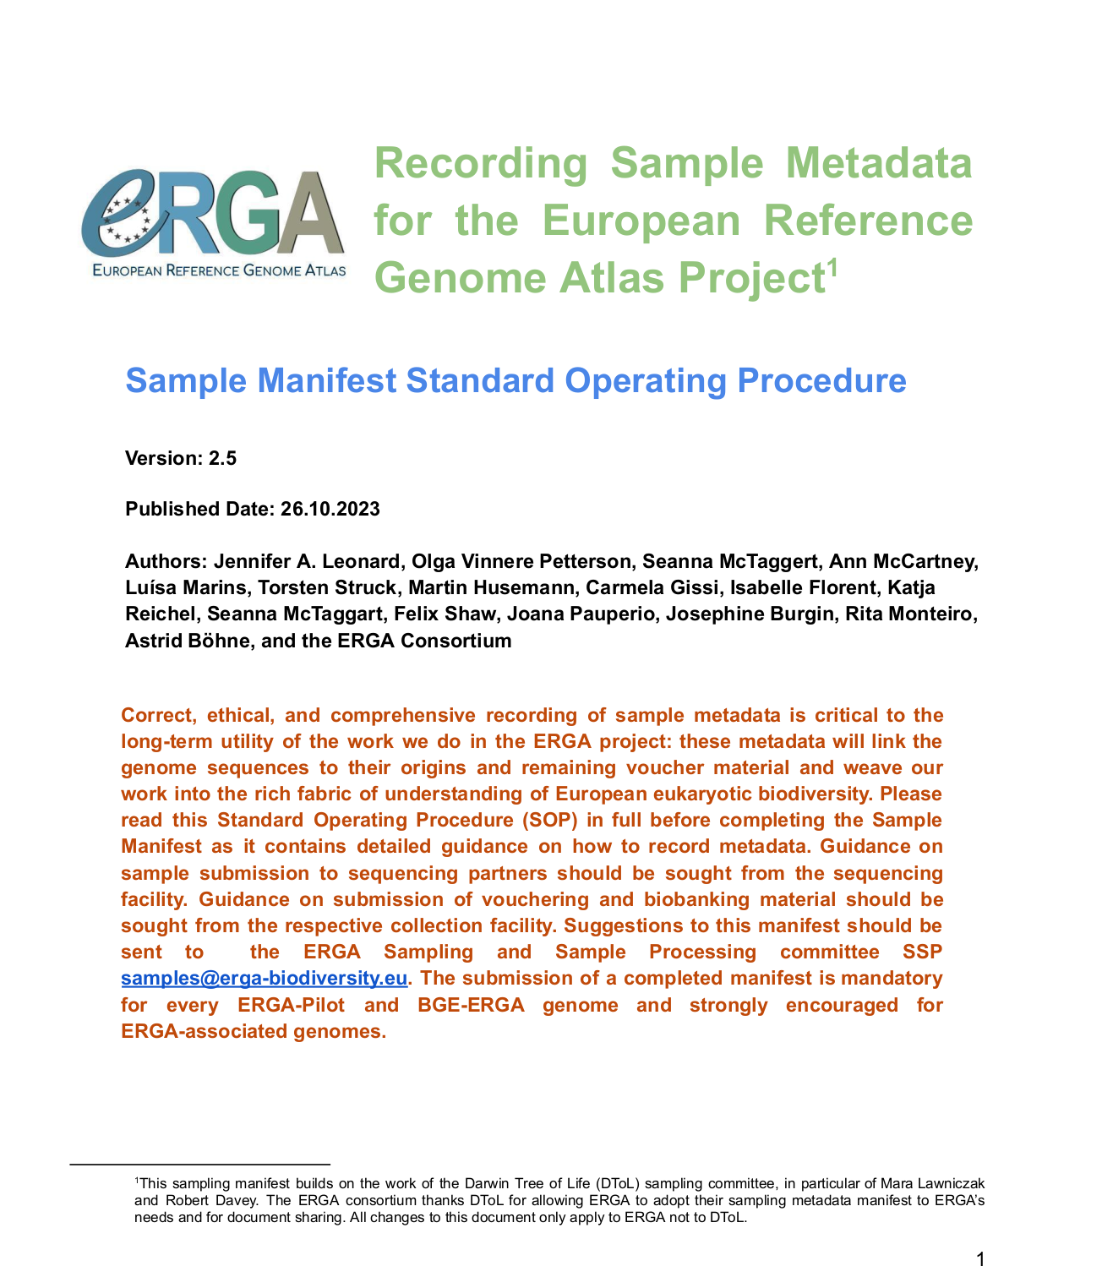
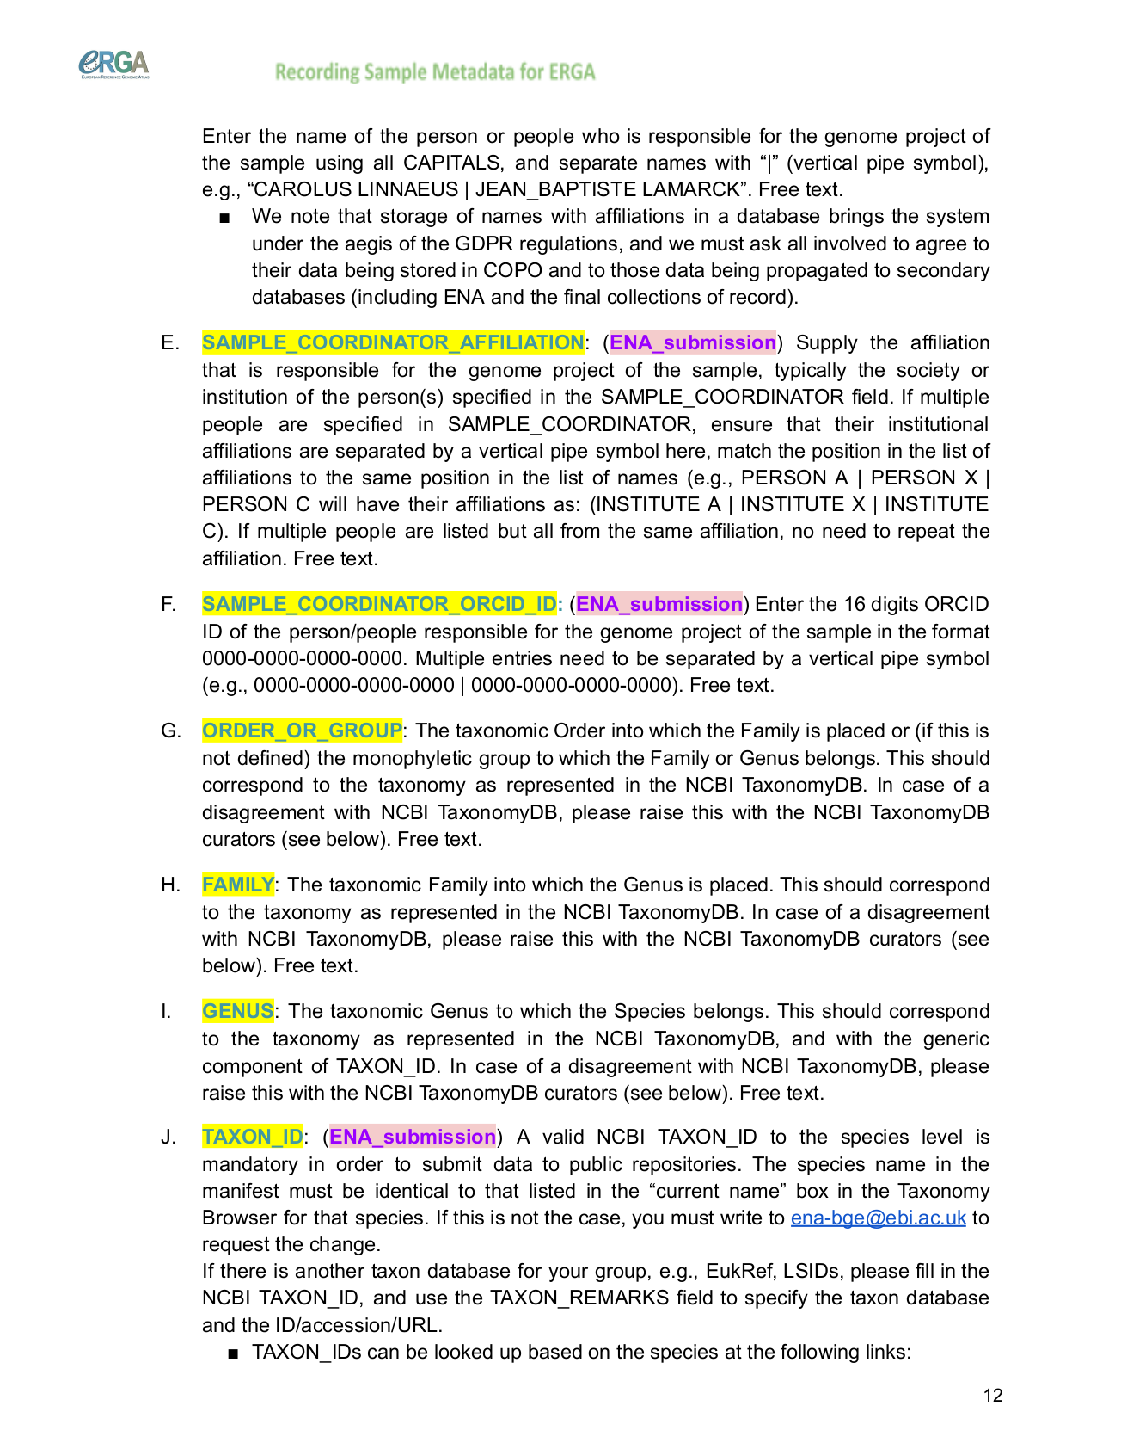
Brokering different types of data
European Reference Genome Atlas (ERGA) Standard Operating Procedure (SOP) for sample submission
7

Slide 8
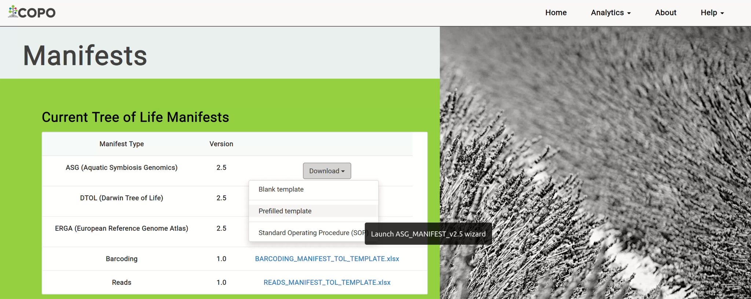
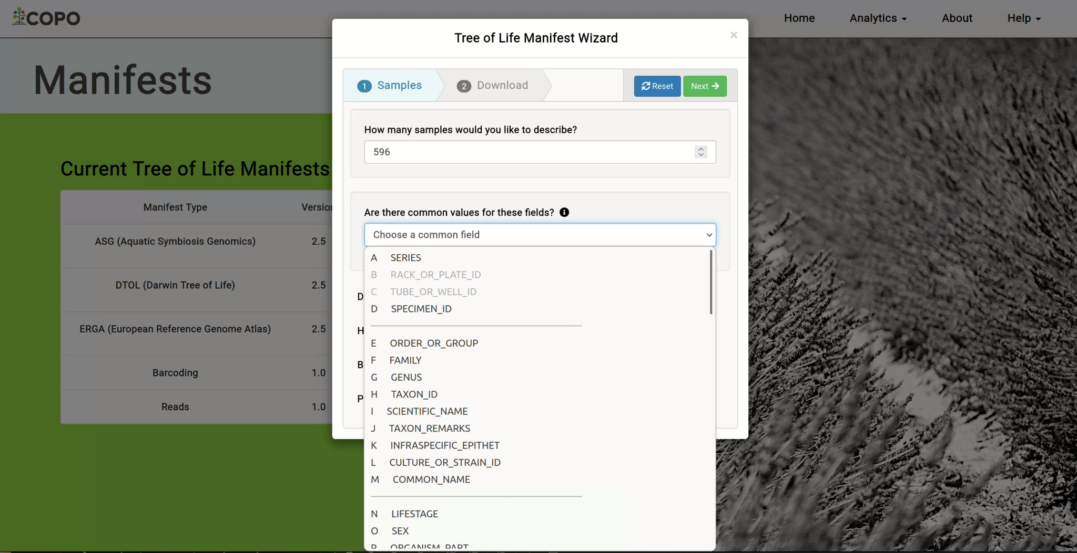
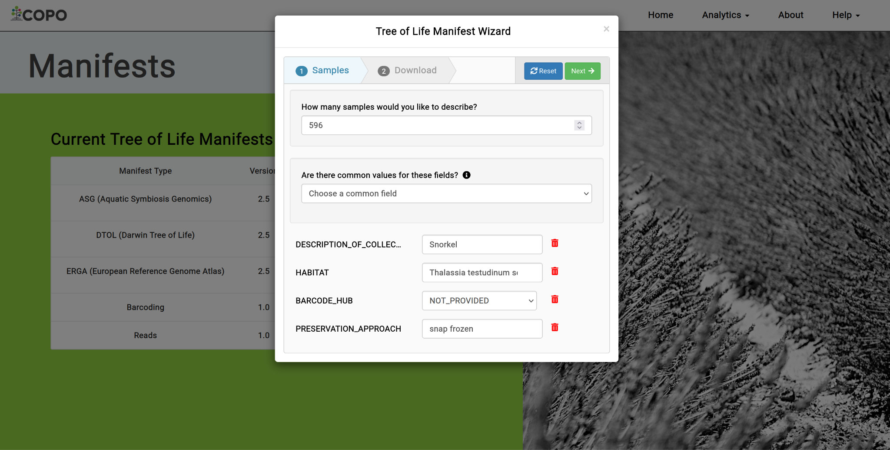
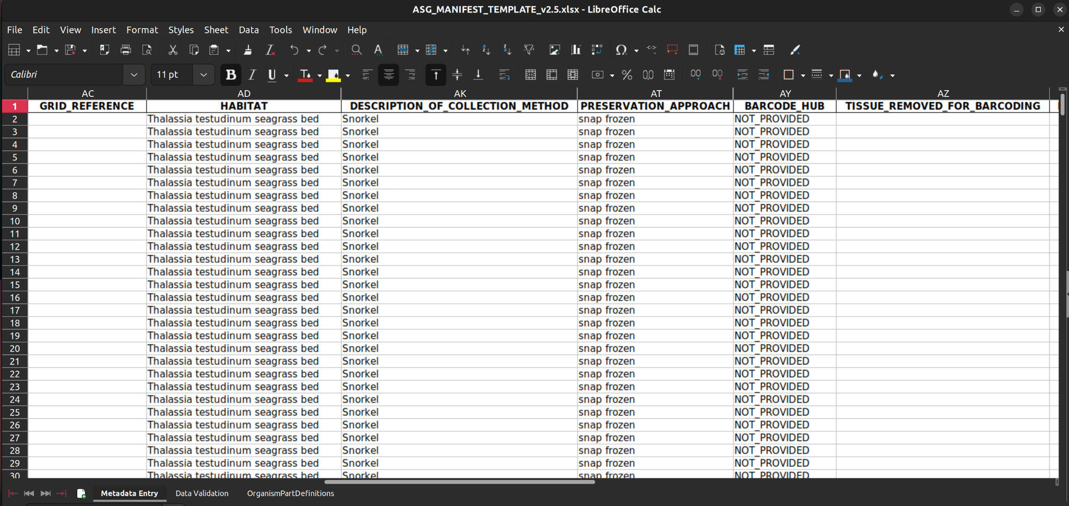
Brokering different types of data
Using COPO’s Manifest wizard to generate a prefilled manifest
8
Notes:
Drawbacks: the prefilled manifest does not have the column headings colour nor the colours are not show in the common field value dropdown menu
Number of columns/fields:
ASG: 68
DTOL: 68
ERGA: 91
____________________________________________________________________
DTOL blocks
Block 1: Sample submission information including specimen identifier and tube/well identifiers (columns A to D) green
Block 2: Taxonomic information including species name, family and common name (columns E to M)
Block 3: Biological information of the sample including lifestage, sex, and organism part (columns N to R)
Block 4: Details of the submitting GAL and the associated organisational codes (columns S and T)
Block 5: Data on the collector, collection event, and collection localities (columns U to AL)
Block 6: Information on taxonomic identification, taxonomic uncertainty and risks (columns AM to AQ)
Block 7: Details of the tissue preservation event (columns AR to AX)
Block 8: Information on DNA barcoding (columns AY to BF)
Block 9: Information on vouchering and biobanking (columns BG to BK)
Block 10: Additional info

Slide 9
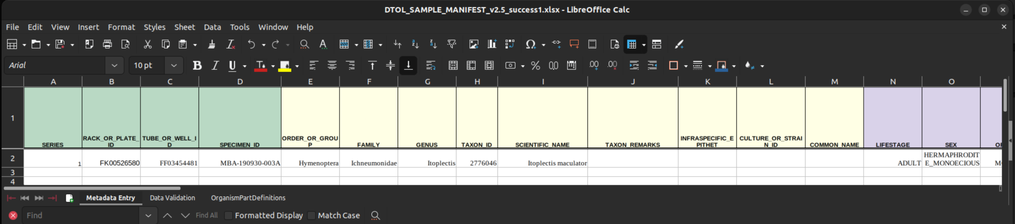
Brokering different types of data
Samples
DToL Sample Manifest
9
Notes:
Number of columns/fields:
ASG: 68
DTOL: 68
ERGA: 91
____________________________________________________________________
DTOL blocks
Block 1: Sample submission information including specimen identifier and tube/well identifiers (columns A to D) green
Block 2: Taxonomic information including species name, family and common name (columns E to M)
Block 3: Biological information of the sample including lifestage, sex, and organism part (columns N to R)
Block 4: Details of the submitting GAL and the associated organisational codes (columns S and T)
Block 5: Data on the collector, collection event, and collection localities (columns U to AL)
Block 6: Information on taxonomic identification, taxonomic uncertainty and risks (columns AM to AQ)
Block 7: Details of the tissue preservation event (columns AR to AX)
Block 8: Information on DNA barcoding (columns AY to BF)
Block 9: Information on vouchering and biobanking (columns BG to BK)
Block 10: Additional info

Slide 10
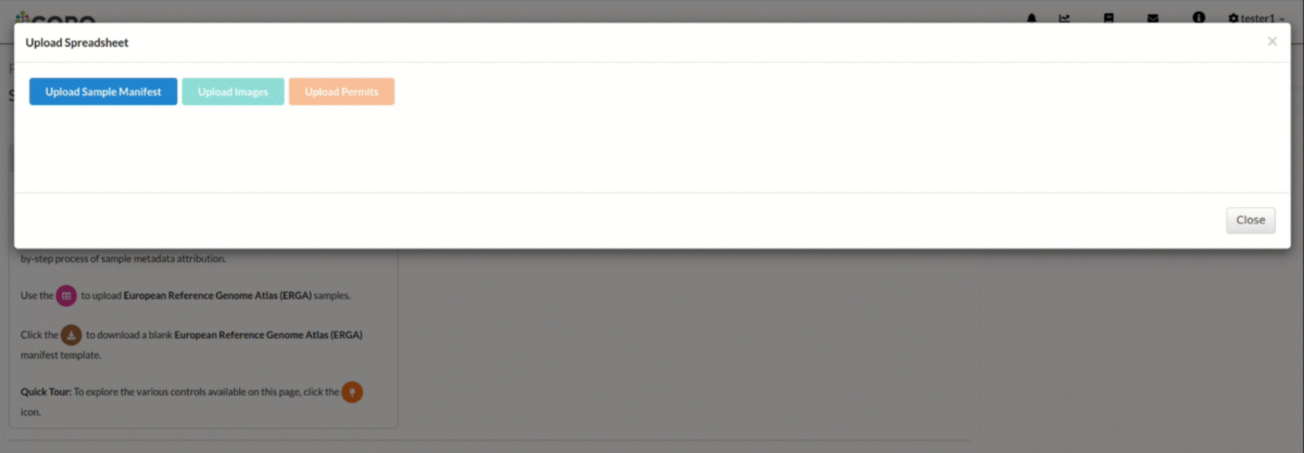
Brokering different types of data
Samples submission and validation process
10
Notes:
Appropriate error messages are shown if samples fail submissions:
Empty field values for required fields
FIeld values are in an incorrect format like date fields only instead of datetime etc.
Appropriate warning messages are shown if for example there are:

Slide 11

Brokering different types of data
Samples
As of 19th April, 2024, COPO has brokered:
4,197 ASG samples
32,455 DToL samples
2,315 ERGA samples
1,270 ERGA-BGE samples
477 ERGA-Pilot samples
11

Slide 12
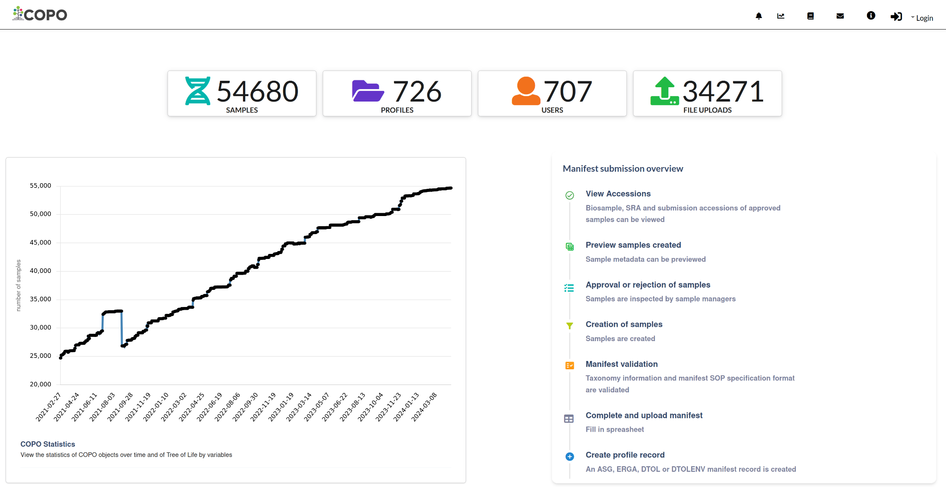
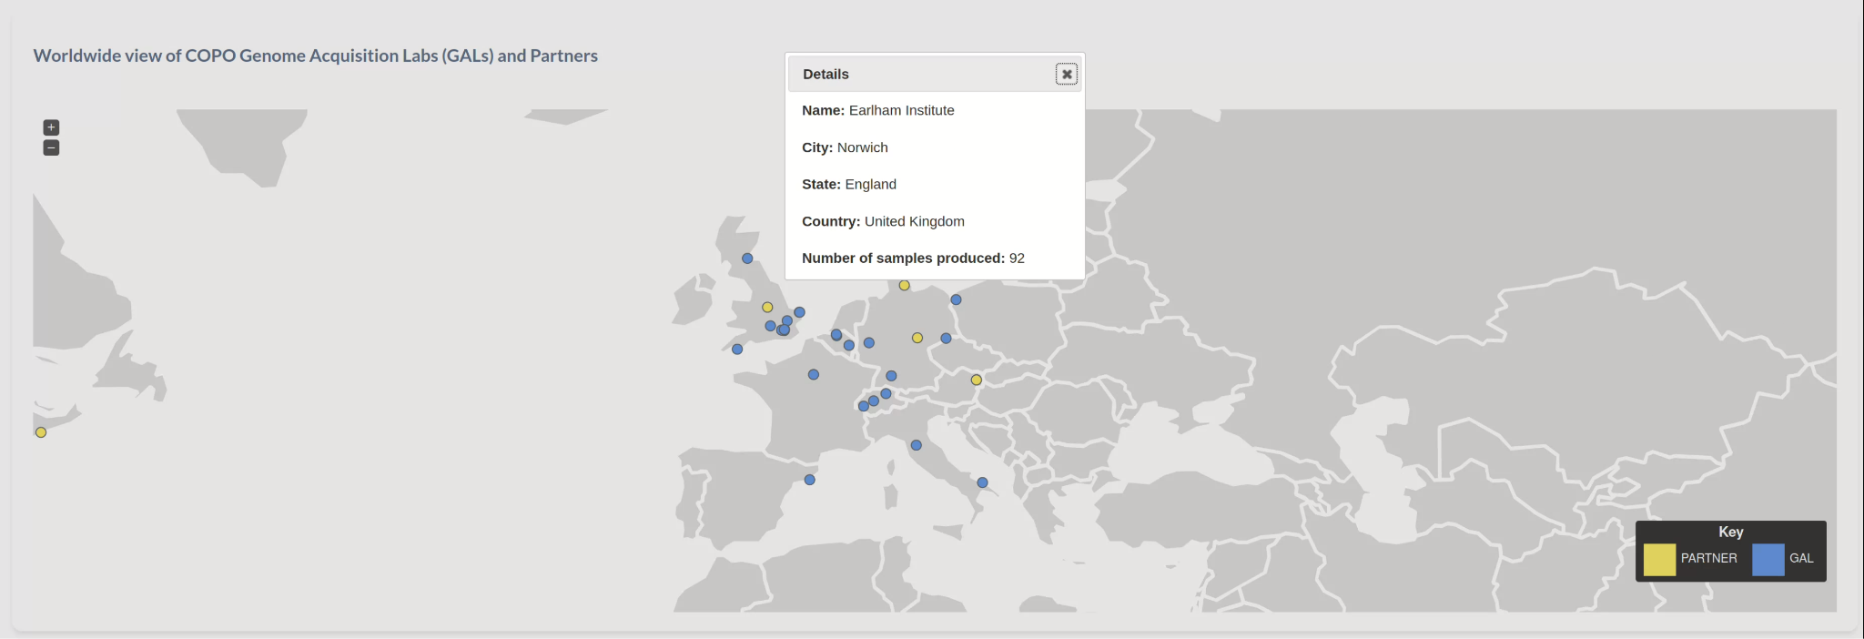
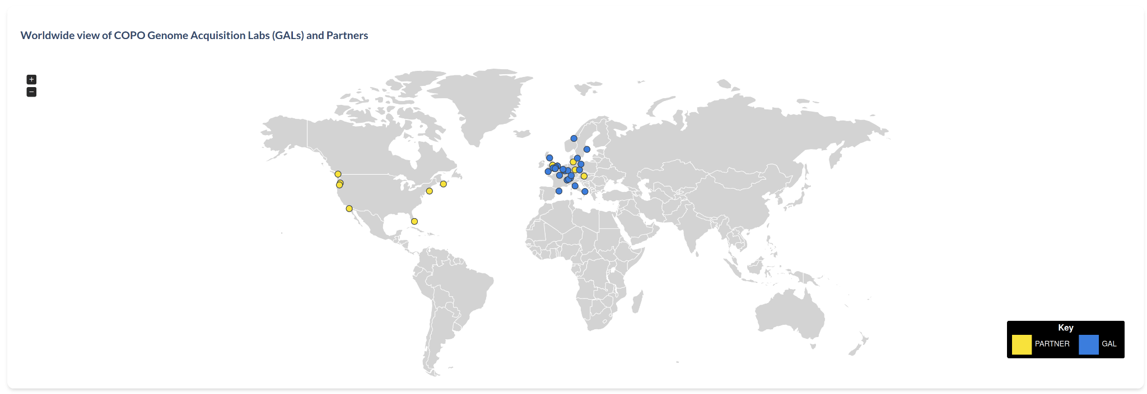

Analysing brokered data
Tree of Life Dashboard
https://copo-project.org/copo/tol_dashboard/tol
12
Notes:
PARTNERS: Queen Mary University of London, University of British Columbia, The Sainsbury Laboratory
GALs: Sanger Institute, Royal Botanic Garden in Edinburgh and Kew, Natural History Museum, EI, Genoscope

Slide 13
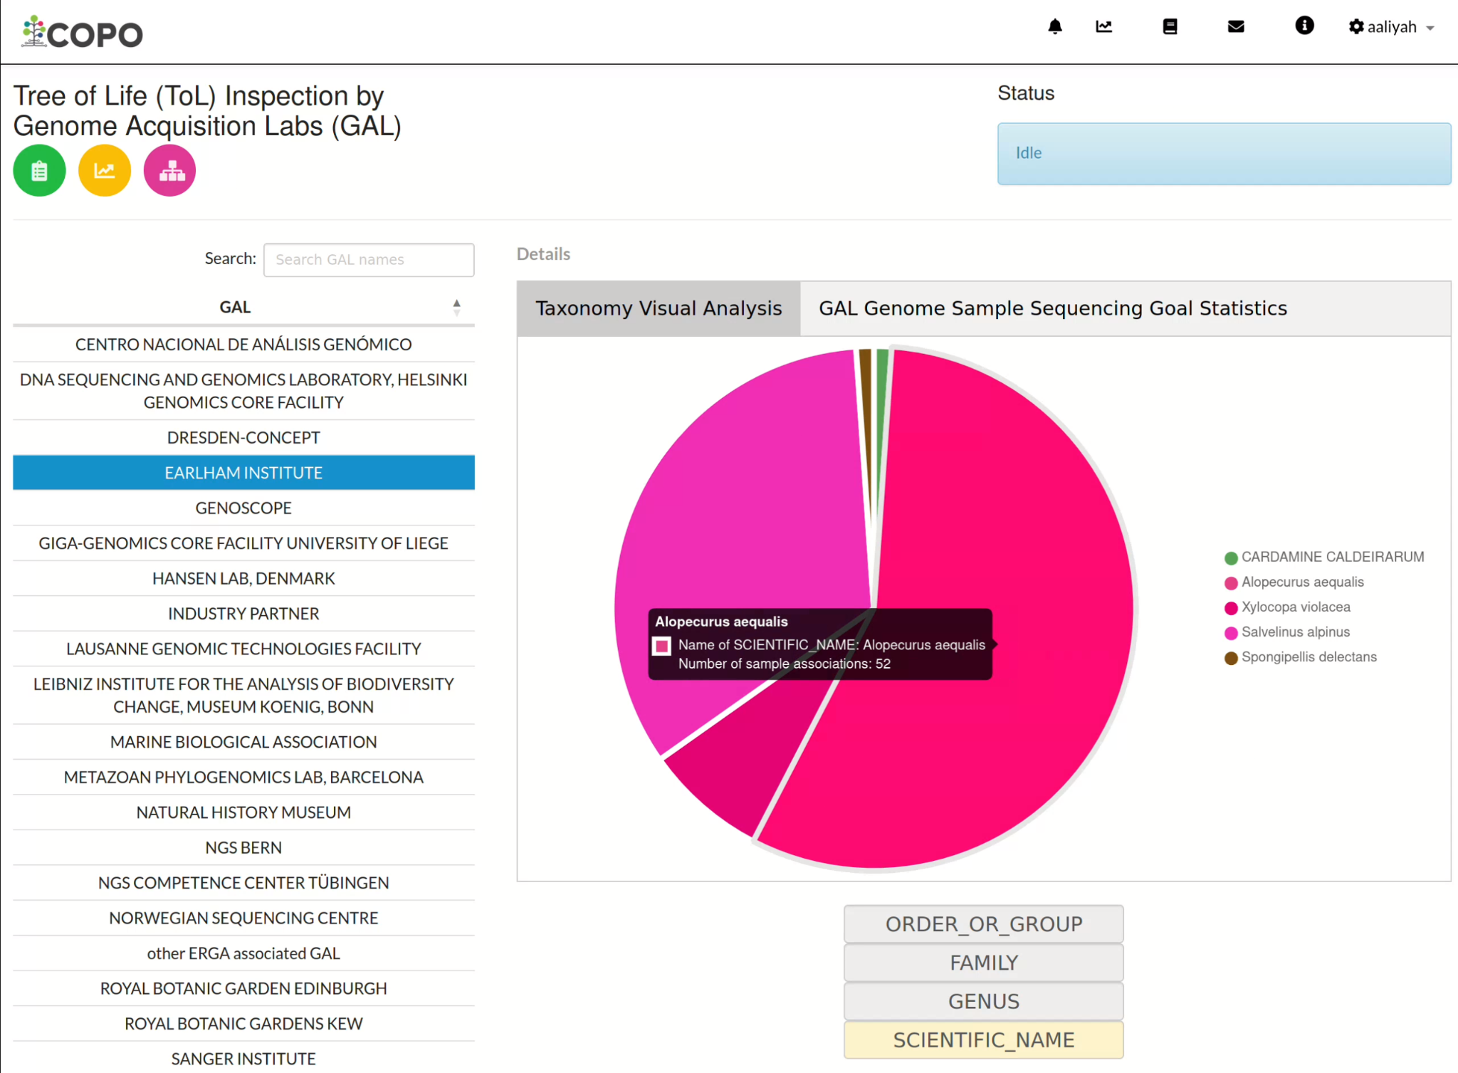
Analysing brokered data
ToL Inspection by GAL web page
Query samples by Genome Acquisition Lab (GAL)
Analyse the number of samples associated within each GAL by taxonomy
https://copo-project.org/copo/tol_dashboard/tol_inspect/gal
13

Slide 14
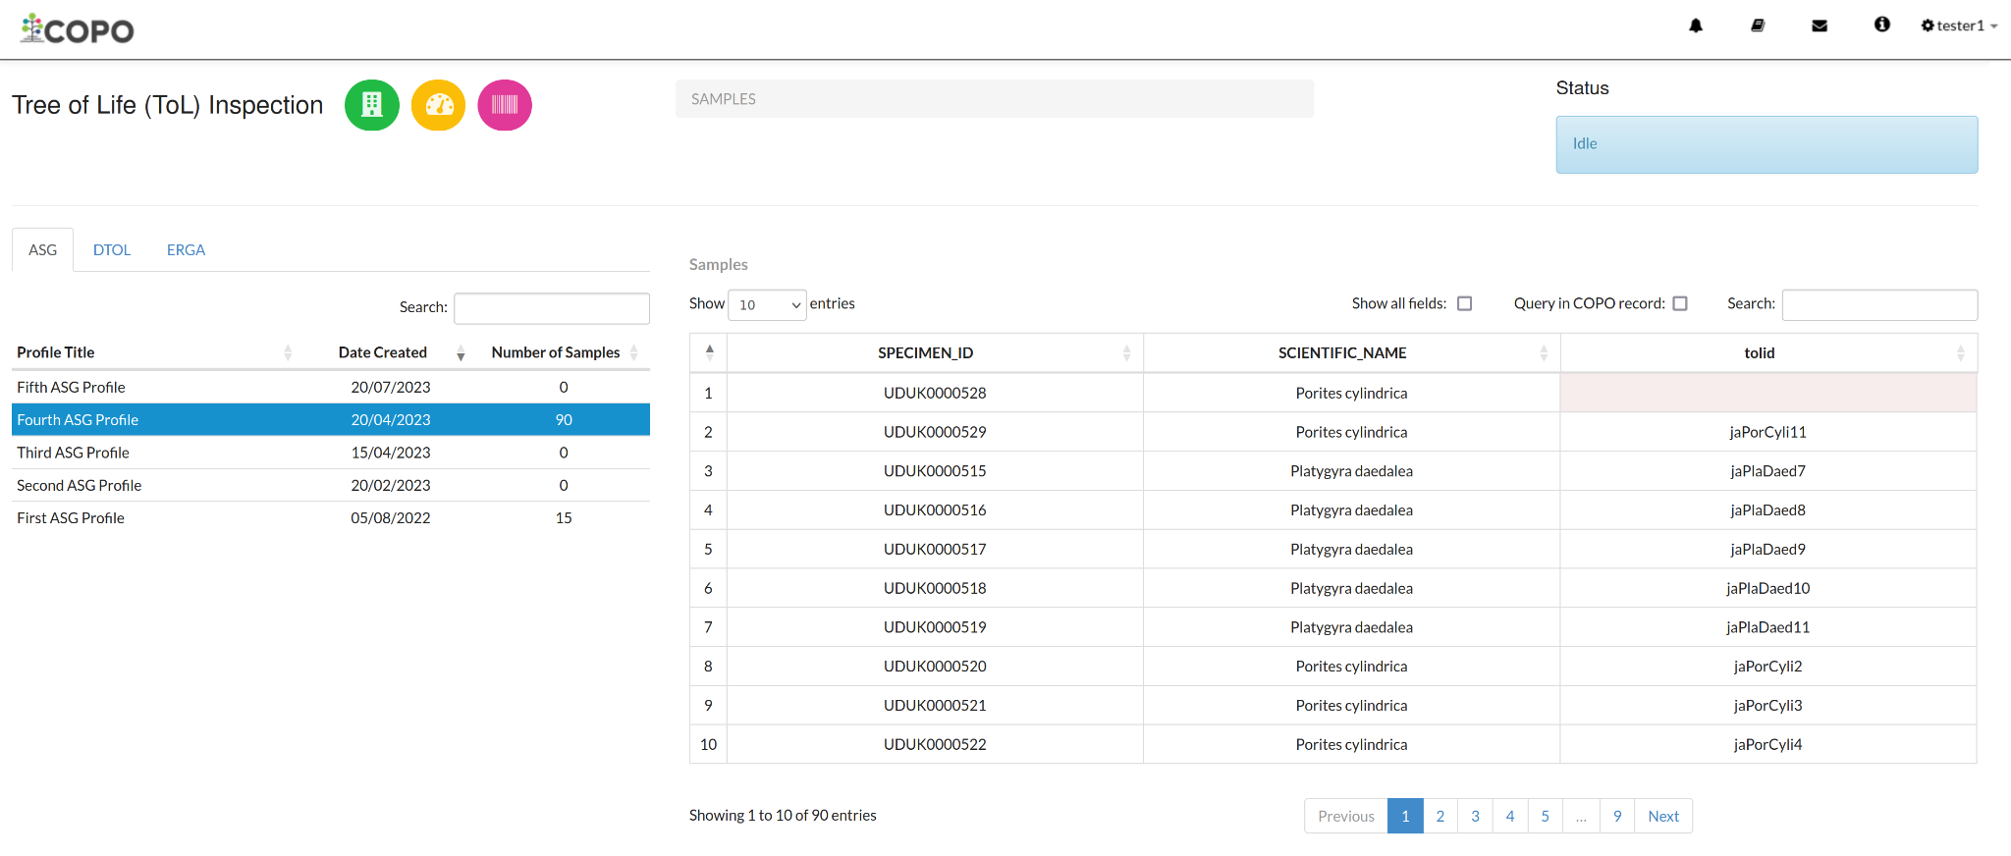
Analysing brokered data
ToL Inspection web page
https://copo-project.org/copo/tol_dashboard/tol_inspect
14
Notes:
Query samples by profile
Query samples by project type

Slide 15
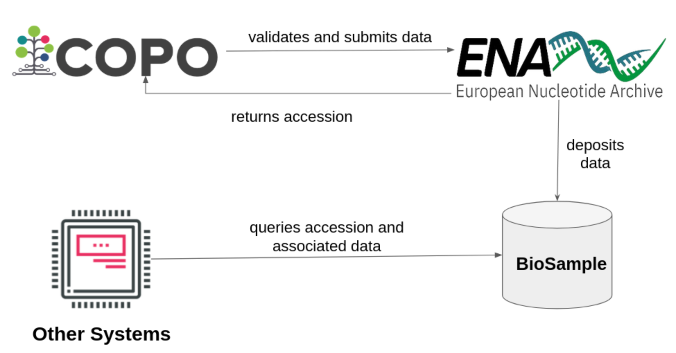
Data deposition to ENA
A subset of submitted metadata is sent to ENA
An unique identifier (accession) is returned which can be used in other systems thereby enhancing interoperability
ENA synchronises submitted data with other systems like (BioSample database in) National Centre for Biotechnology Information (NCBI) and Genomes on a Tree (GoaT)
15
Notes:
NCBI - National Centre for Biotechnology Information
ENA - European Nucleotide Archive
GOAT - Genomes on a Tree

Slide 16
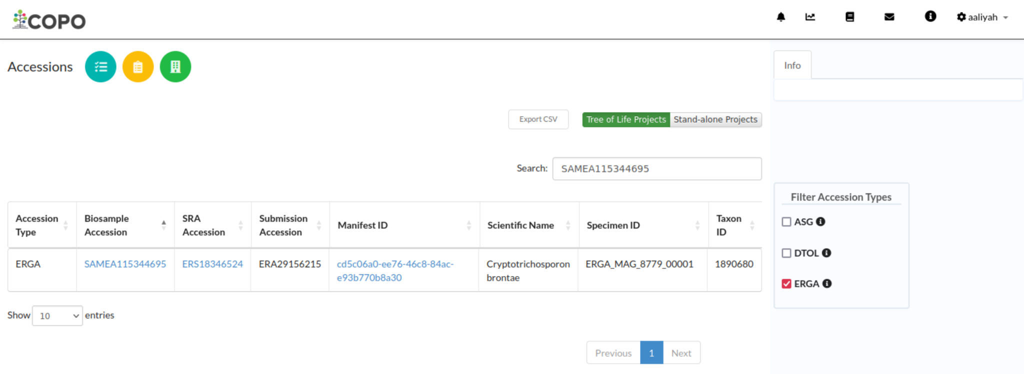
Viewing sample SAMEA115344695 on COPO Accessions Dashboard
https://copo-project.org/copo/copo_accessions/dashboard
16

Slide 17
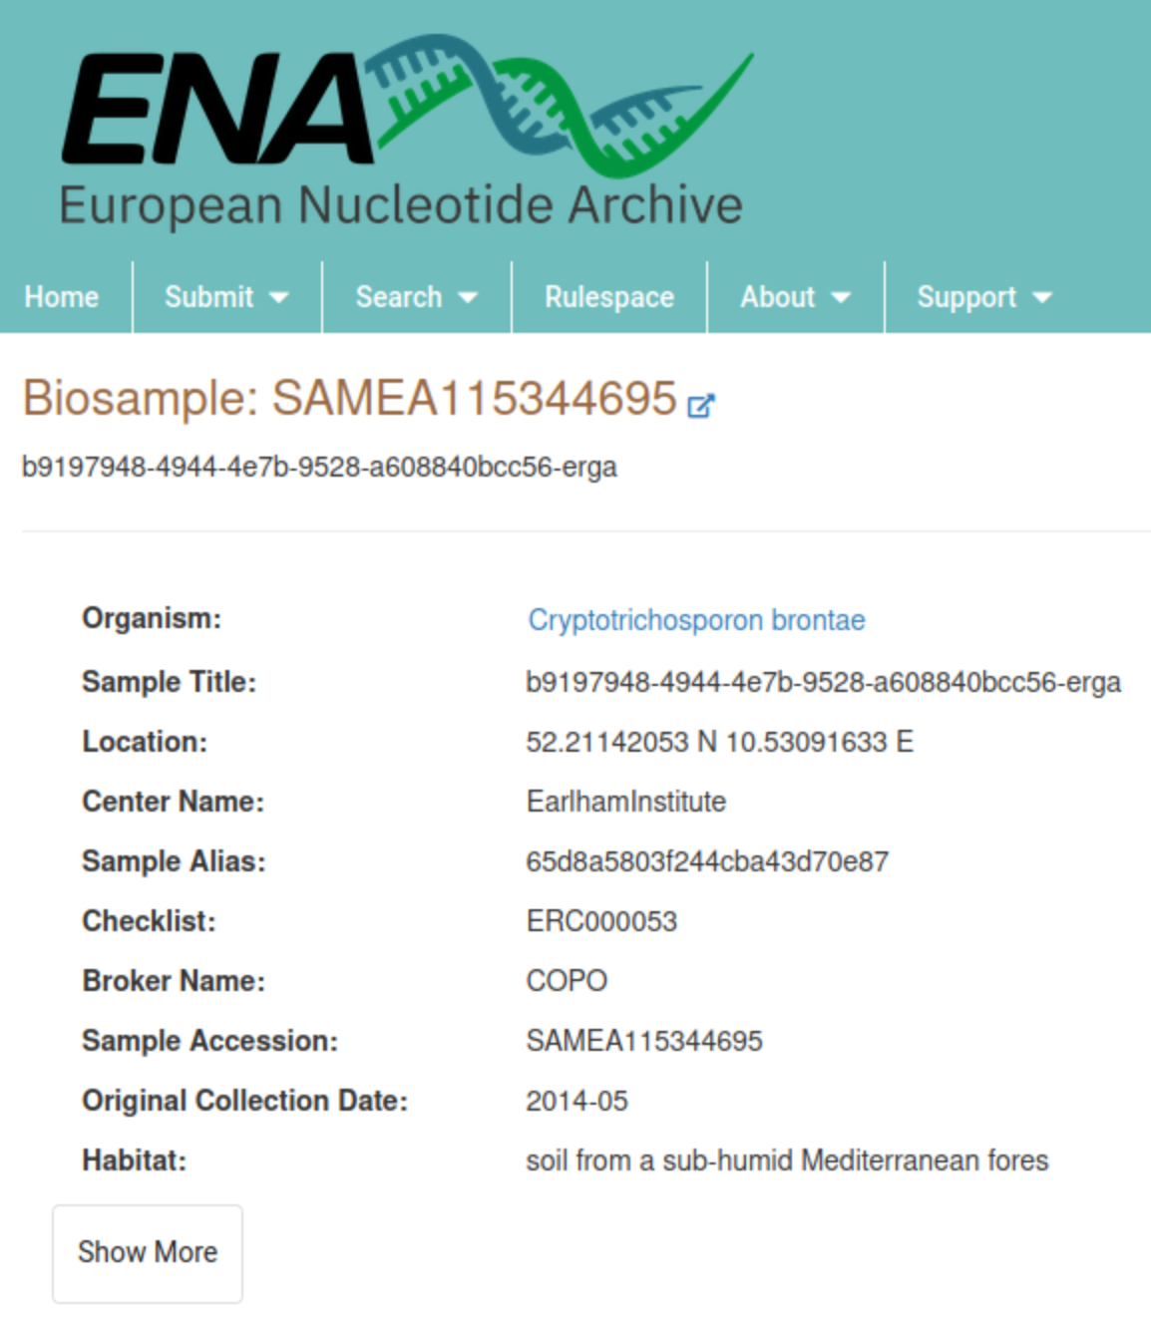
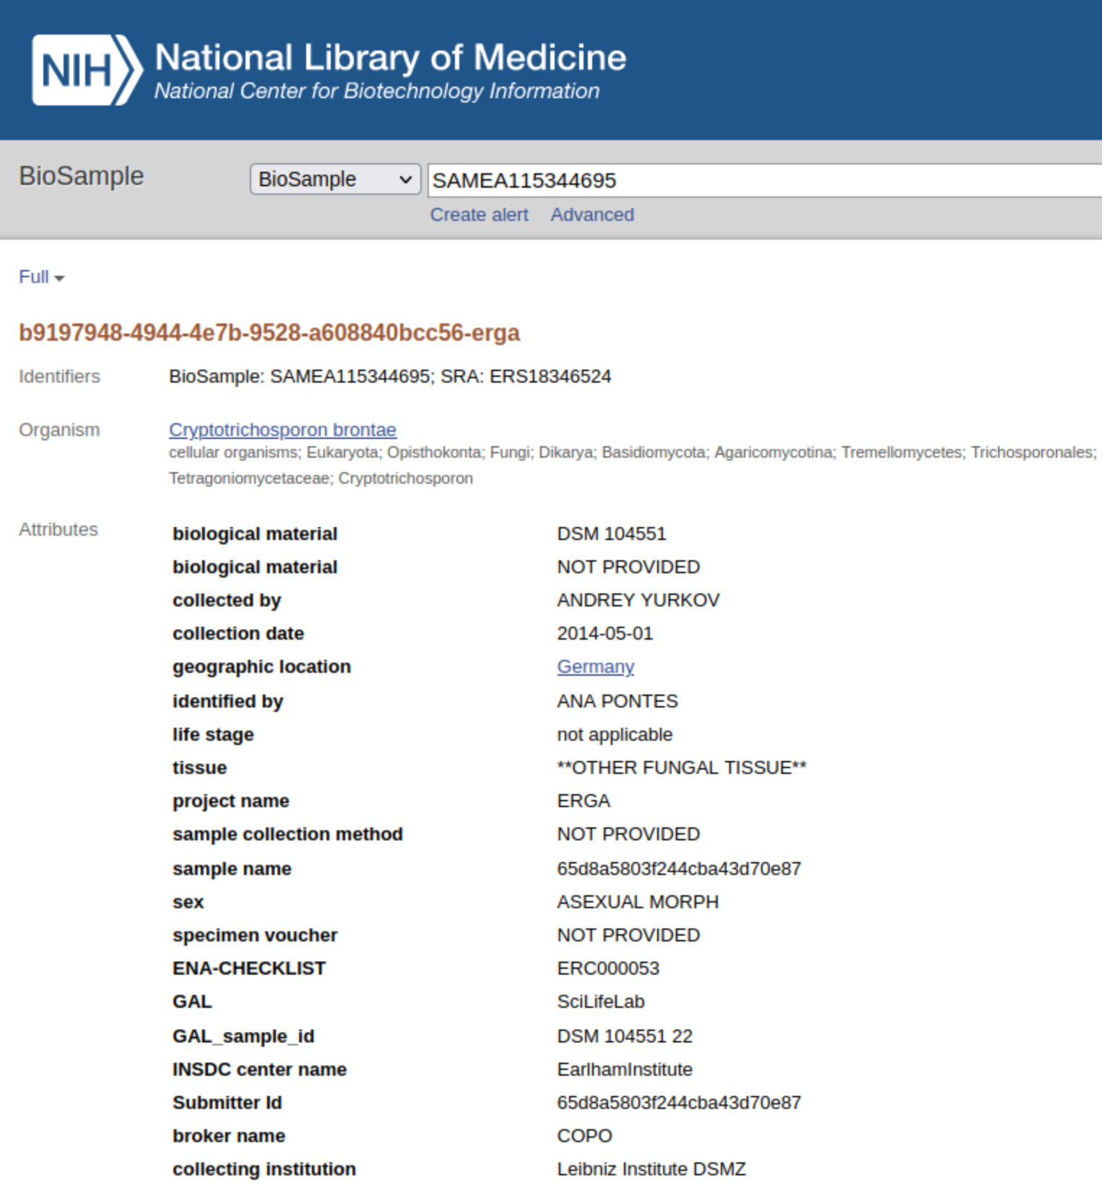
https://www.ebi.ac.uk/ena/browser/view/SAMEA115344695
https://www.ncbi.nlm.nih.gov/biosample/?term=SAMEA115344695
17
Notes:
NCBI - National Centre for Biotechnology Information
ENA - European Nucleotide Archive
GOAT - Genomes on a Tree

Slide 18
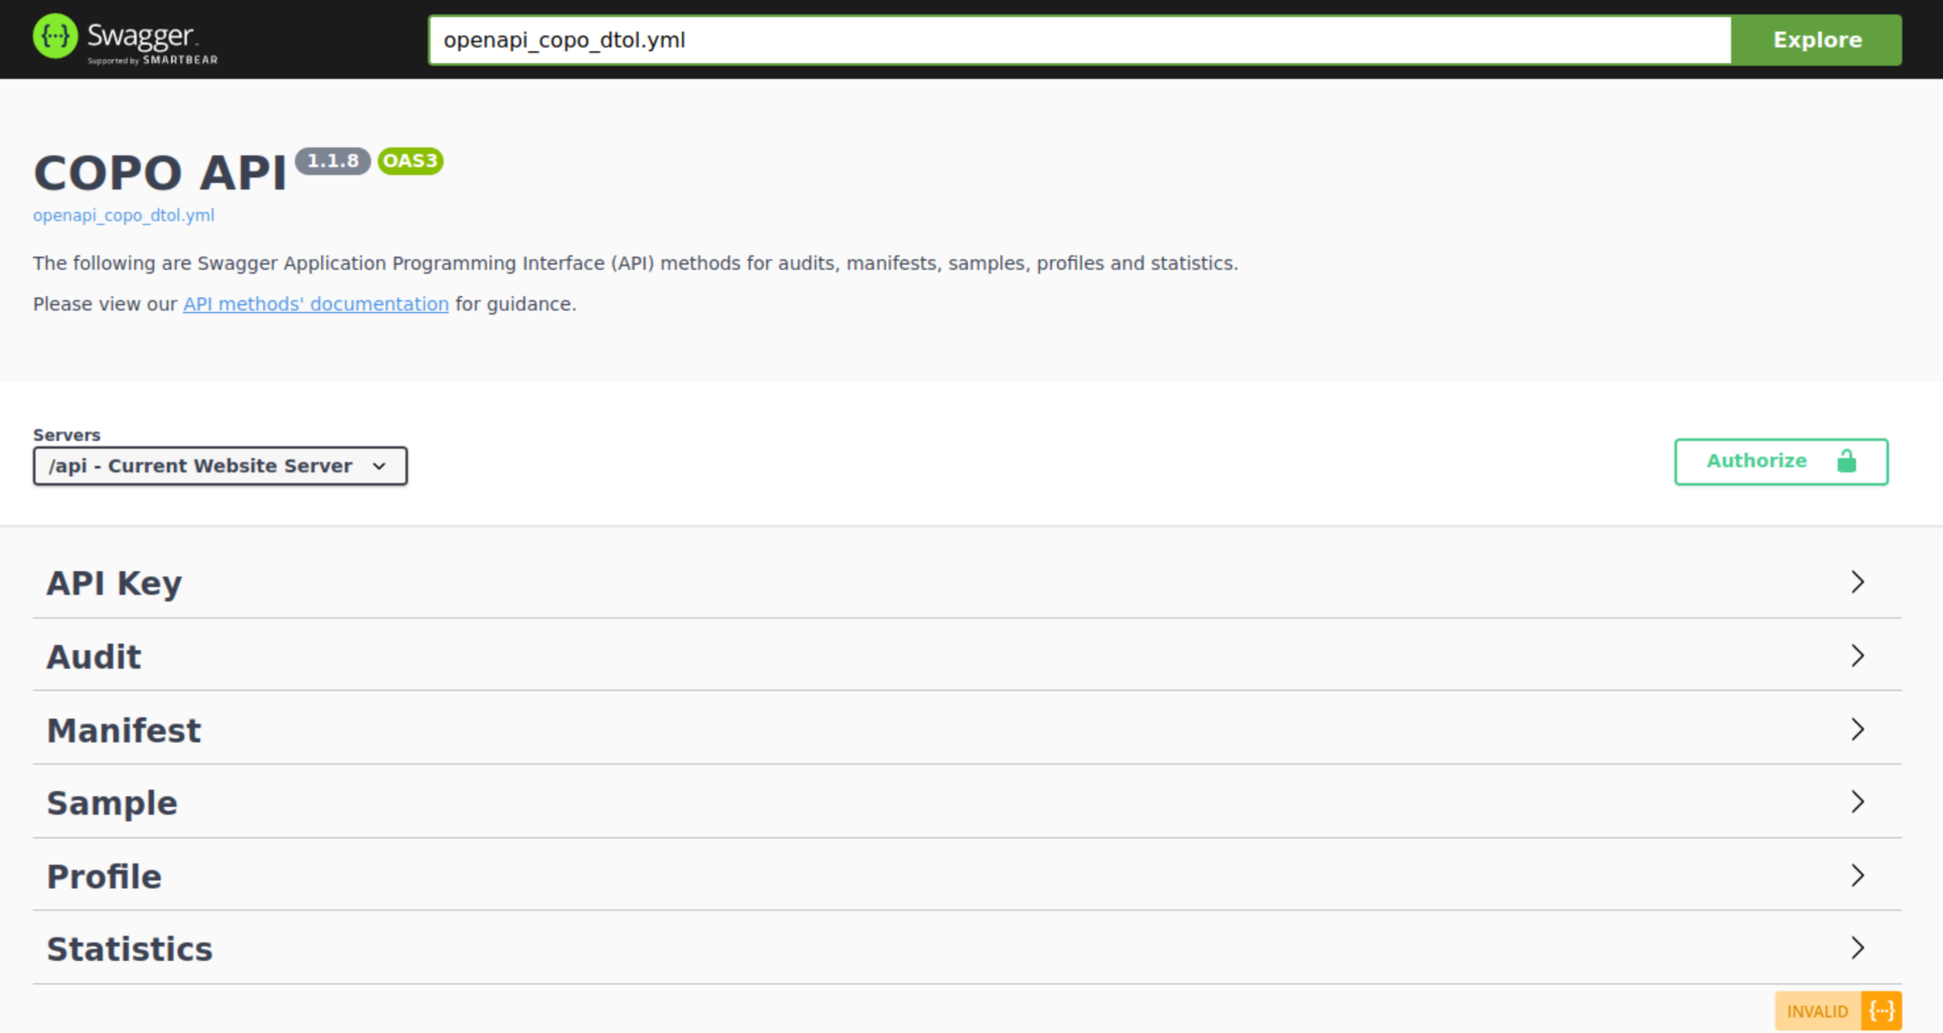
Querying data submissions
Using COPO API methods
Swagger, an open-source framework, is used to build REST APIs
API results can be retrieved in .csv format or .json format
Sample data updates can be queried using the Audit API methods
Data submissions can be queried using the manifest and sample API methods
https://copo-project.org/api
18
Notes:
Point #1: Swagger API is an open-source framework that enables one to build and develop API methods through the usage of OpenAPI specifications
Point #2: Owing to your analysis requirement, you may want to retrieve data in a particular format. COPO provides results in .json format, csv format as well as rocrate format (at manifest level)
Point #3:

Slide 19
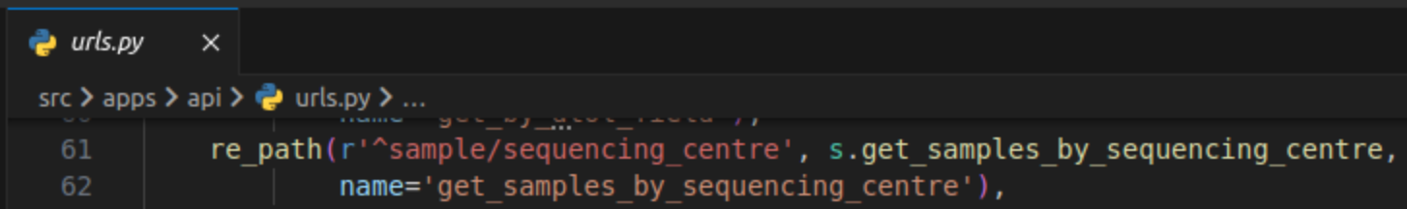
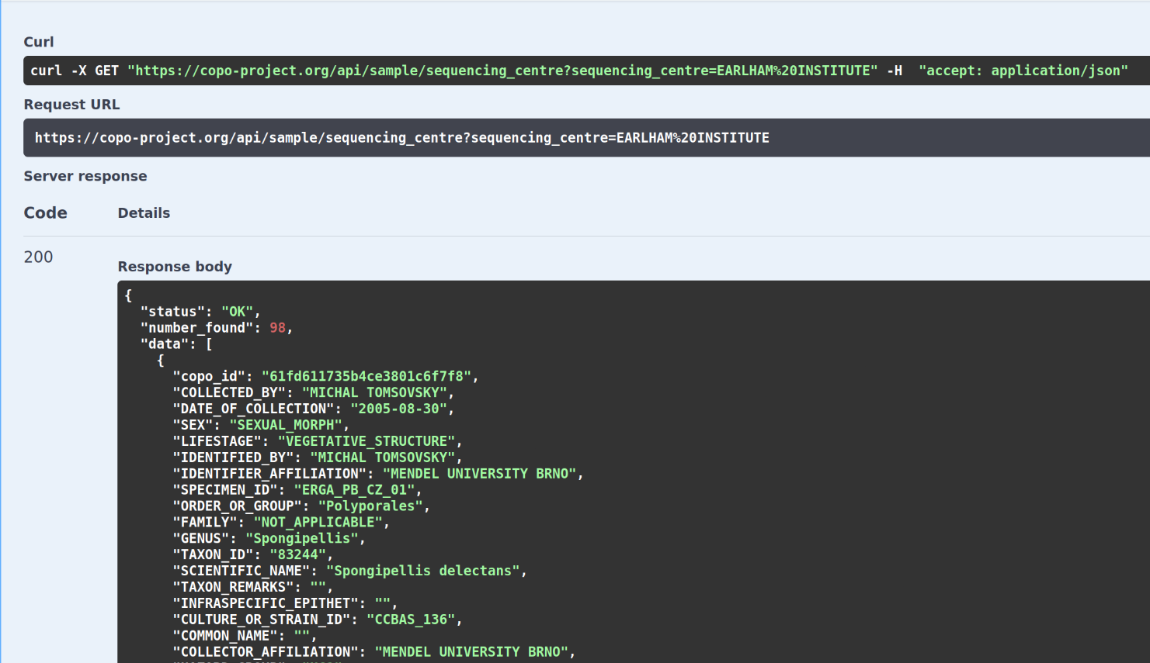
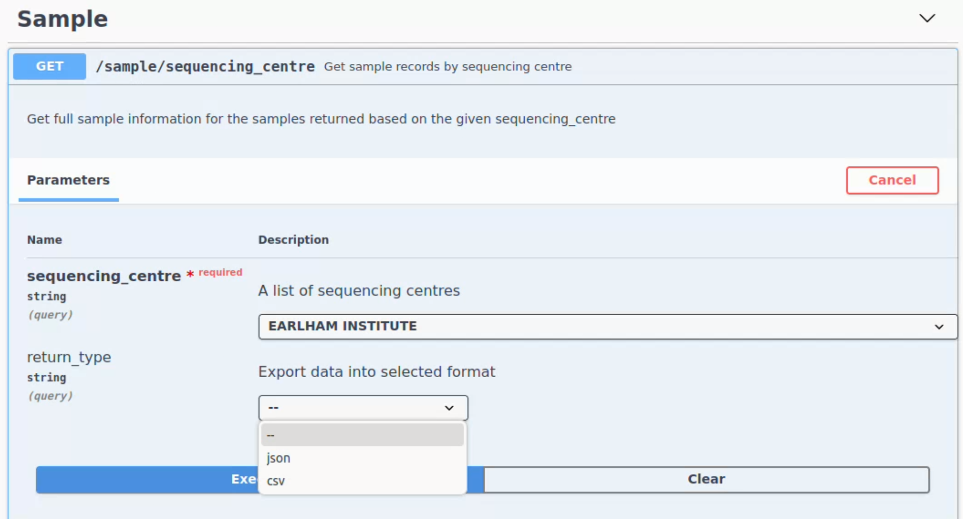
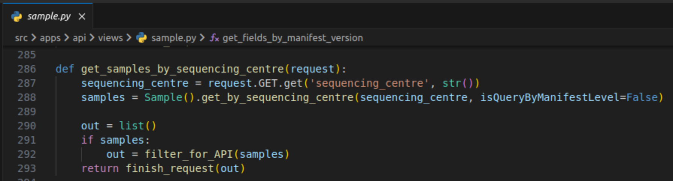
Querying data submissions
Using COPO API methods | Sample
19

Slide 20
Future tasks
Phenotyping image data submission
Image manifest will include Minimum Information About a Plant Phenotyping Experiment (MIAPPE), Recommended Metadata for Biological Images (REMBI), ToL sample data
Deposit image-base datasets to:
Comprehensive Knowledge Archive Network (CKAN)
Zenodo
Enhance COPO APIs to display a mapping of ToL metadata field/column names to other standards - ENA, Darwin Core (DWC), Minimum Information about any (x) Sequence (MIxS)
This enhances interoperability since systems may be compliant with other standards
20
Notes:
Tree of Life Checklist (ERC000053) - Minimum information required for reporting samples associated with the Tree of Life (ToL) Programme

Slide 21
Summary
COPO is in operation for over 9 years. September 2024 will make 10 years.
Samples, reads, sequencing annotations, assemblies, barcodes, data files and sample images can be submitted to COPO.
Data submitted is published to ENA
Sample image data is submitted to BioImage Archive (BIA)
ERGA sample permits are submitted to B2DROP
21

Slide 22

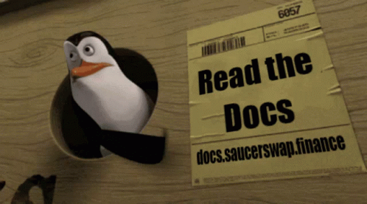
Need to submit data to ENA?
Submit your data to COPO by visiting: https://copo-project.org/copo
If you encounter any issues or have enquiries, contact the COPO team who would be happy to assist you.
ei.copo@earlham.ac.uk
http://copo-docs.readthedocs.io
22

Slide 23






Acknowledgements
BGE project
Papatheodorou Group
Rita Monteiro
Felix Shaw
Debby Ku
ERGA project
Astrid Böhne
The Collaborative OPen Omics (COPO) project is supported by the Biotechnology and Biological Sciences Research Council (BBSRC), part of UK Research and Innovation, through the Cellular Genomics (CELLGEN) Grant BBS/E/ER/230001A, Data Infrastructure and Algorithms Group Grant EI-G-Data, Decoding Biodiversity (DECODE): Development of Novel Experimental and Bioinformatic Tools for Genomic Diversity and Analysis Grant BBS/E/ER/230002A and EI - Darwin Tree of Life Grant GP182.
Earlham Institute
Seanna McTaggart
David Wright
Krister Jazz Urog (Alumni)
Will Nash
Wellcome Sanger Institute
Radka Platte
Nancy Holroyd
Ian Still
Notes:
BBSRC - Biotechnology and Biological Sciences Research Council
CELLGEN - Cellular Genomics
DECODE - Decoding Biodiversity
____________________________
Seanna McTaggart - Programme Manager for the Darwin Tree of Life project

